Slide 1
MOVIES
An example of a database, routes, and authentication

Slide 2
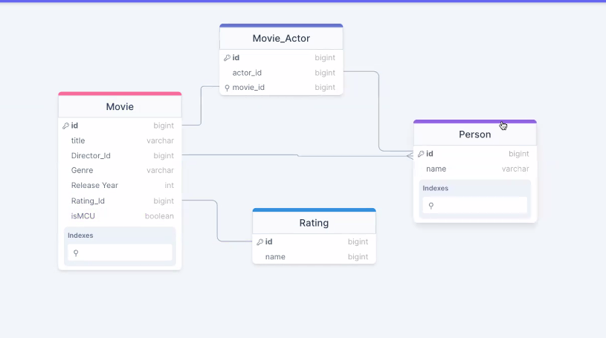
Create schema

Slide 3
Npm init –y
Npm install prisma - - save – dev
Npx prisma init
Create database --- if postgres is installed: createdb dbname

Slide 4
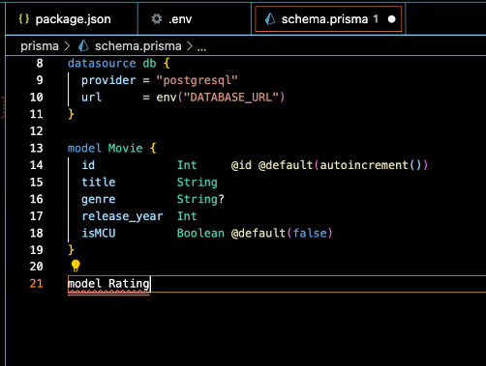
Setting up the Schema
@id says unique and primary key
@default provides default value
@default{autoincrement()} updates for unique id

Slide 5
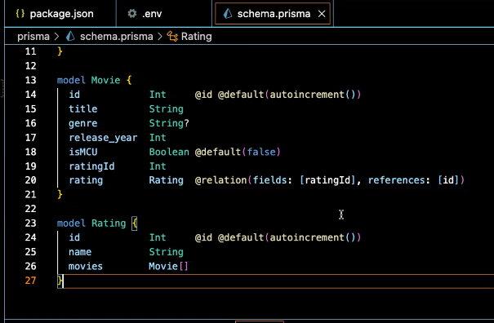
Setting up the Schema
Many to one connection
Sets up relationship between ratingID and the id in the Rating table
Needs to be matched in other table
Pay attention to CAPS to denote tables
Lines 19, 20, and 26 are connected

Slide 6
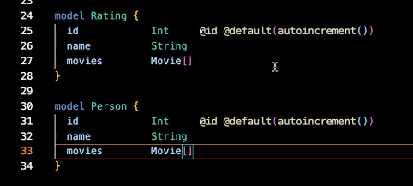
Setting up the Schema
Many to many connection
Lines 27 and 33 are connected many to many

Slide 7
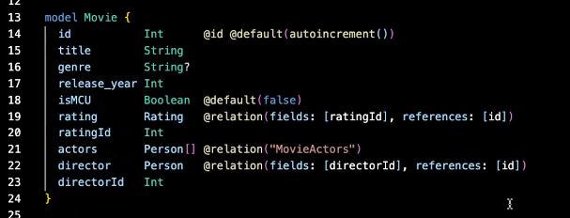
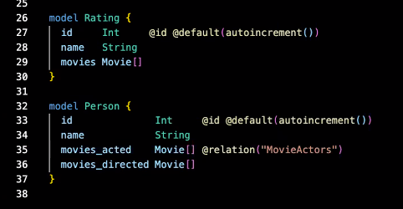
Setting up the Schema
When 2 relations to the same table, need to really define what the connections are

Slide 8
Npx prisma migrate dev - - name init
This will write some sql, create a migration file
Tables are now created in the database
Npx prisma studio -- opens the gui for the database
Create seed.js file

Slide 9
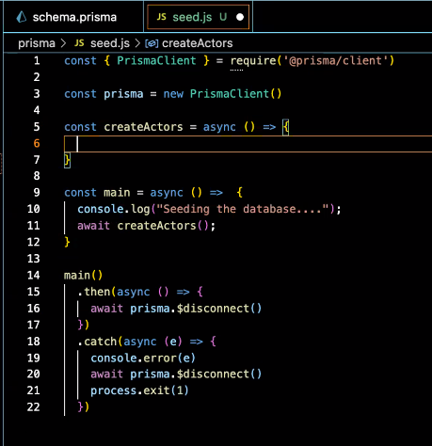
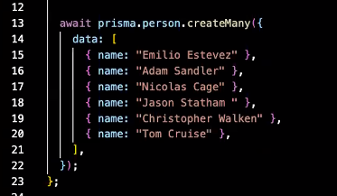
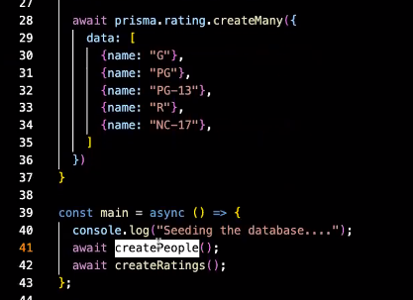
Seed.js
ALL DATABASE OPERATIONS REQUIRE AWAIT

Slide 10
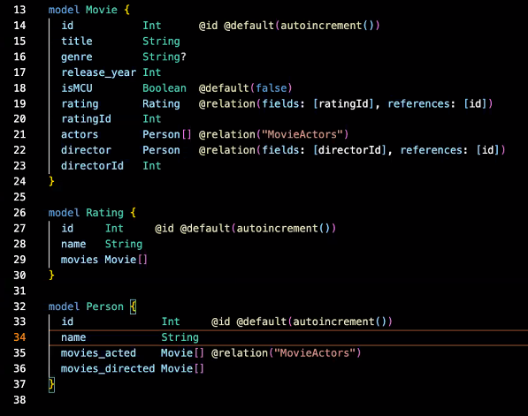
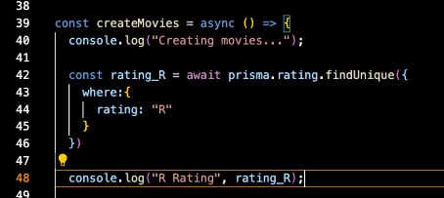
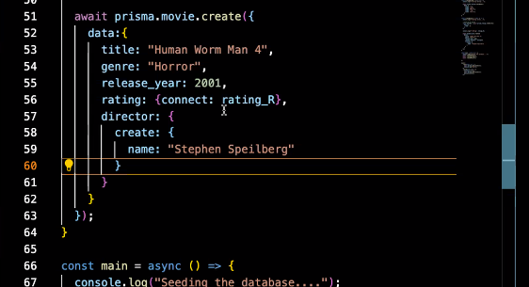
Seed.js

Slide 11
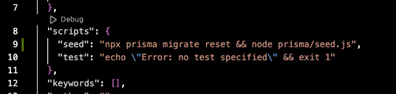
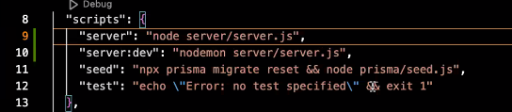
Scripts

Slide 12
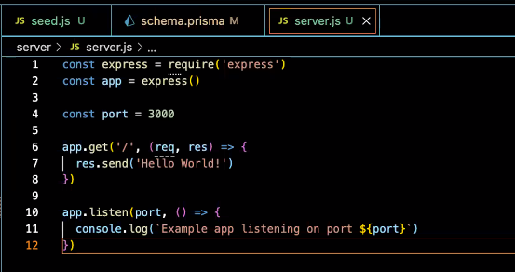
Servers
Create server folder
Create server.js inside
Npm install express
Copy paste from express…
Killall node if nodes are running
Install nodemon - - save-dev
create folder api
Inside api: index.js
then: files for crud based on tables
Starter code for express

Slide 13
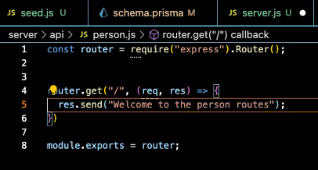
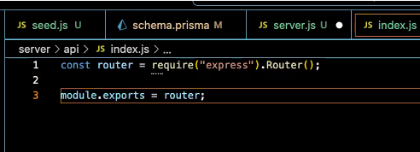
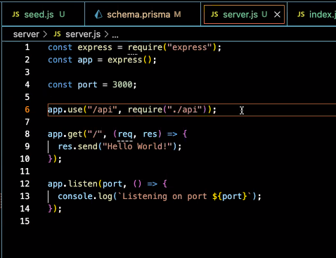
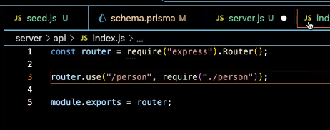
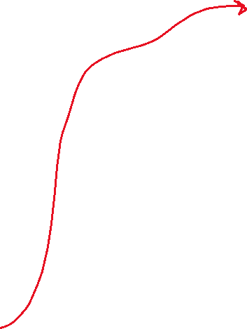
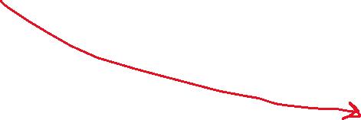
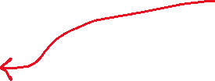
Routes
/api/person.js
Start at Server.js
/api/Index.js
Server.js

Slide 14
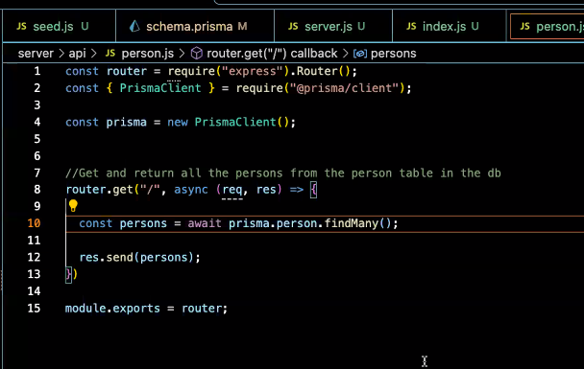
Routes
/api/person.js
Get all persons function

Slide 15
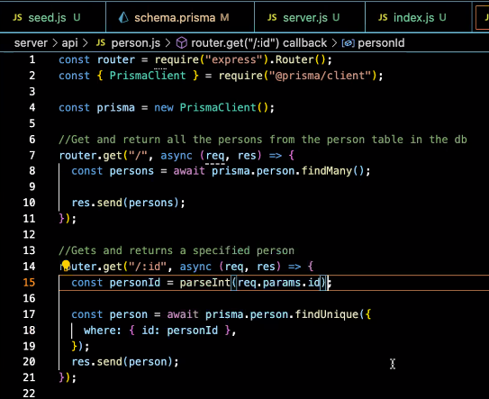
Routes
/api/person.js
Get one person function
Parse to turn string into integer

Slide 16
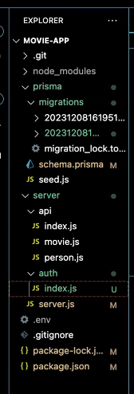
Routes - folders

Slide 17
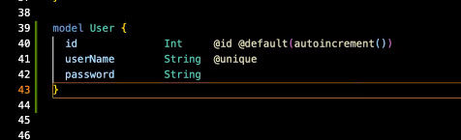
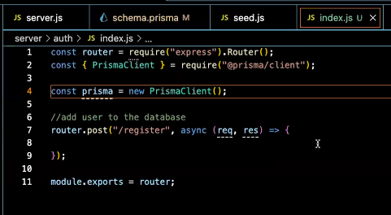
Authentication
Under server folder
Create auth folder
Inside auth folder
create index.js

Slide 18
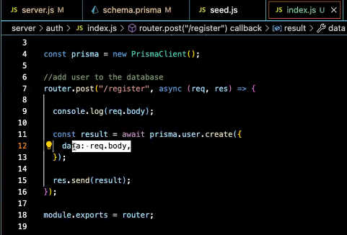
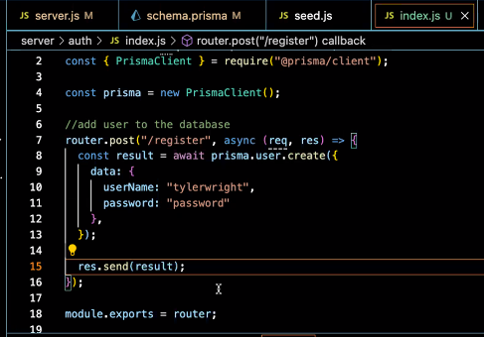
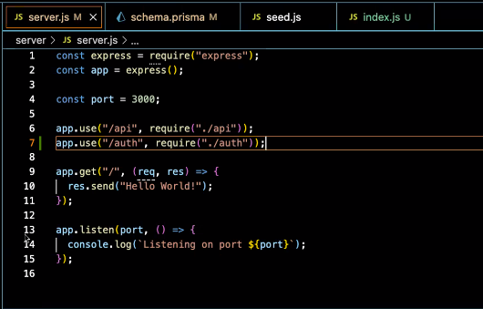
Authentication
Takes body and creates data
Seed.js
Test data
Server.js
Server.js

Slide 19
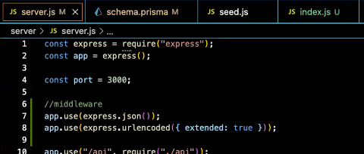
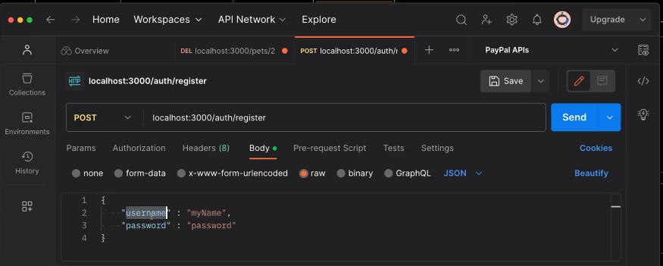
Authentication
Need to get info from the body of the request:
NEEDS MIDDLEWARE
Server.js
Test in postman

Slide 20
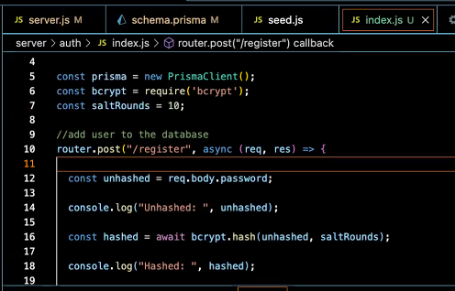

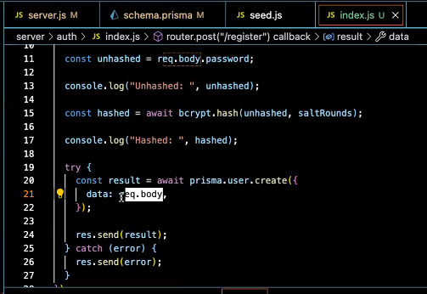
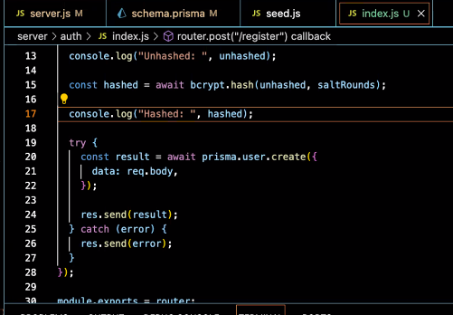
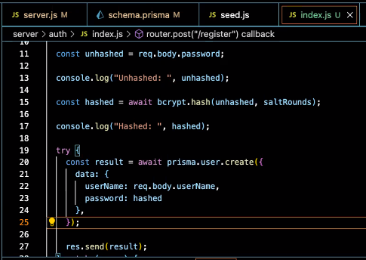
Authentication - bcrypt
Npm install bcrypt
Auth/Index.js

Slide 21
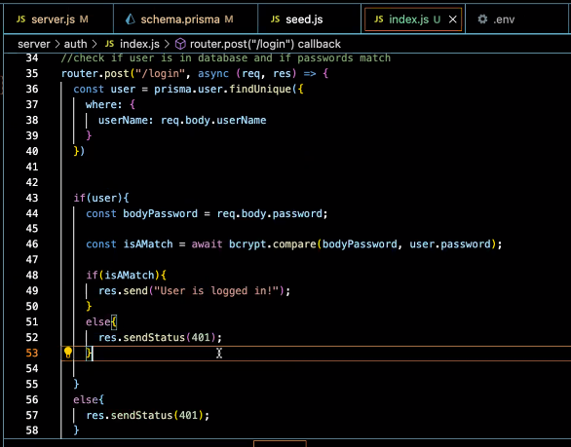
Authentication - bcrypt
Compare username and password to database
Need to add await on line 36

Slide 22
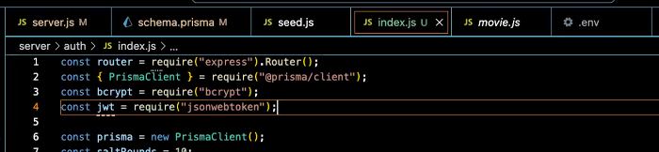
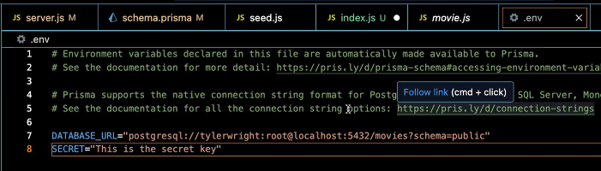
Authentication - tokens
Npm install jsonwebtoken
Npm install dotenv
Auth/Index.js
In the .env file:

Slide 23
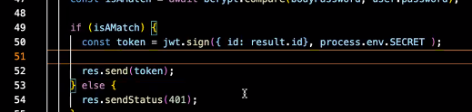

Authentication - tokens
Auth/Index.js
examples

Slide 24
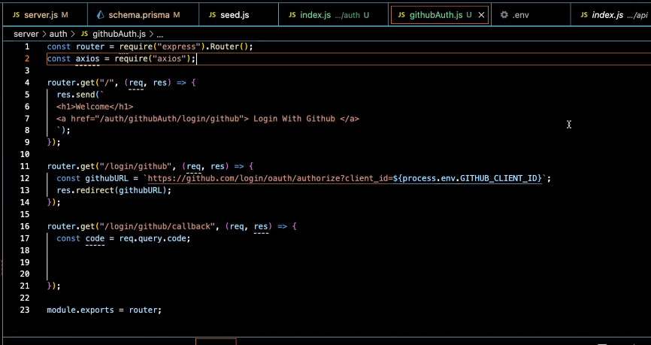
Authentication - oauth
Npm install axios
Require axios

Slide 25
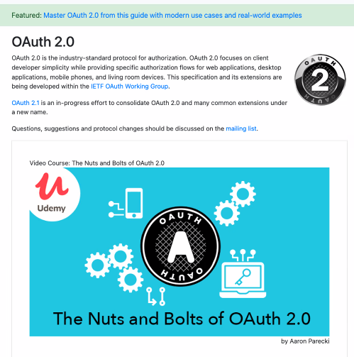
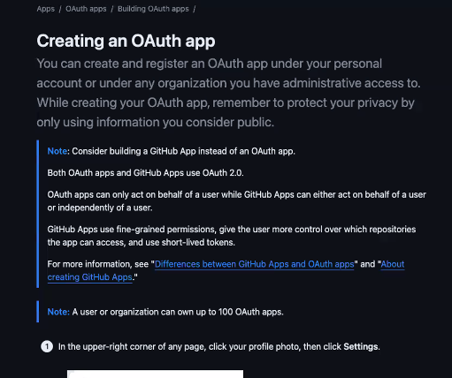
Authentication - oauth

Slide 26
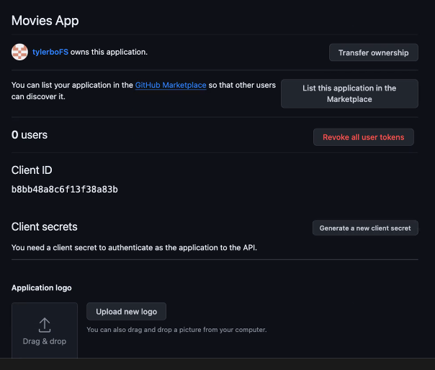
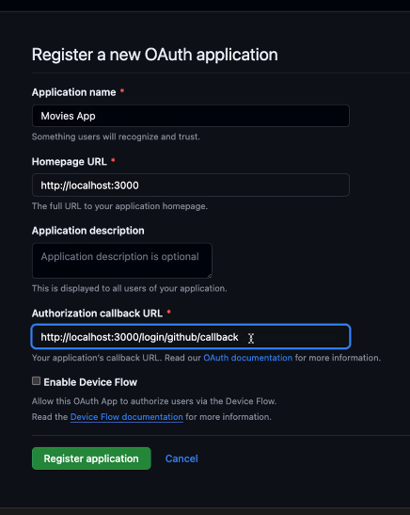
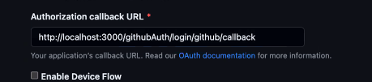
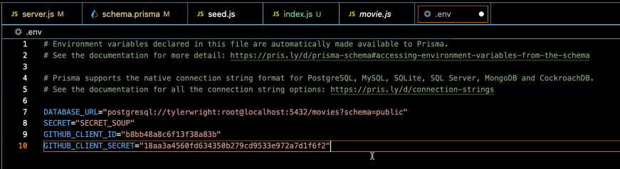

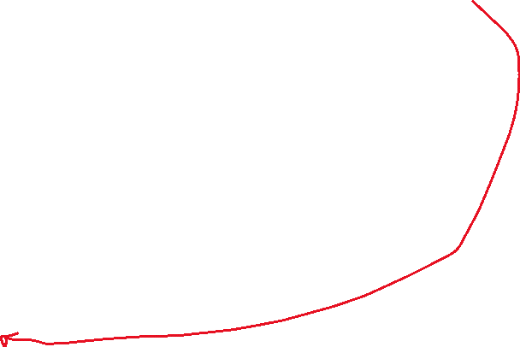
Authentication - oauth
In github

Slide 27

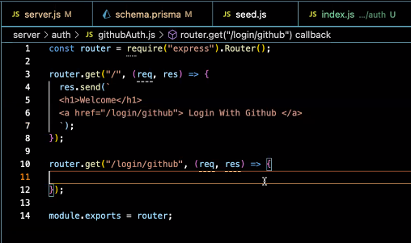
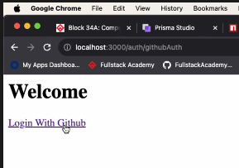
Authentication - oauth
Server.js route to github
Auth/githubAuth.js

Slide 28


Authentication - oauth

Slide 29

Authentication - oauth
githubauth.js
Create route for the callback (given / supplied to github

